Slide 1
What’s happened to QOF
Bruce Guthrie
Professor of General Practice

Slide 2
What was the QOF bargain?
Important driver was recruitment and retention crisis
GPs get increased income/ better working lives
Government gets better quality
Pay for performance attractive to payers
Quality and Outcomes Framework was huge
Did either side get what they wanted?

Slide 3
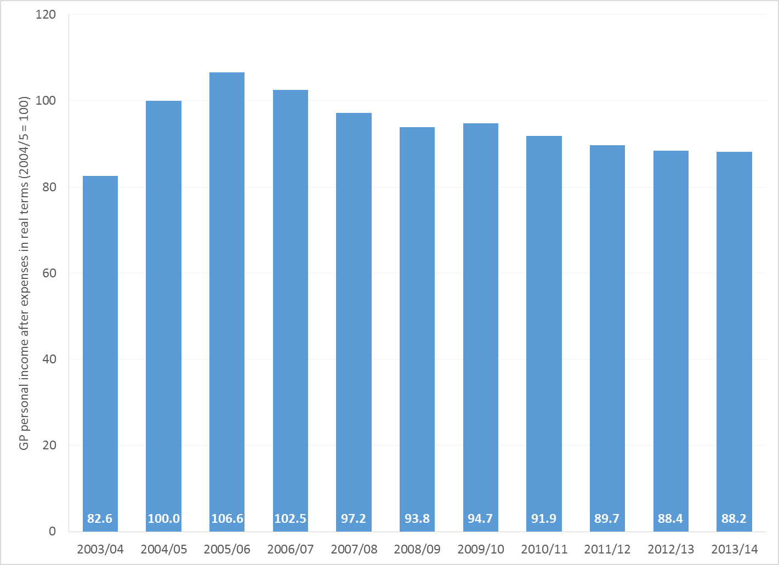
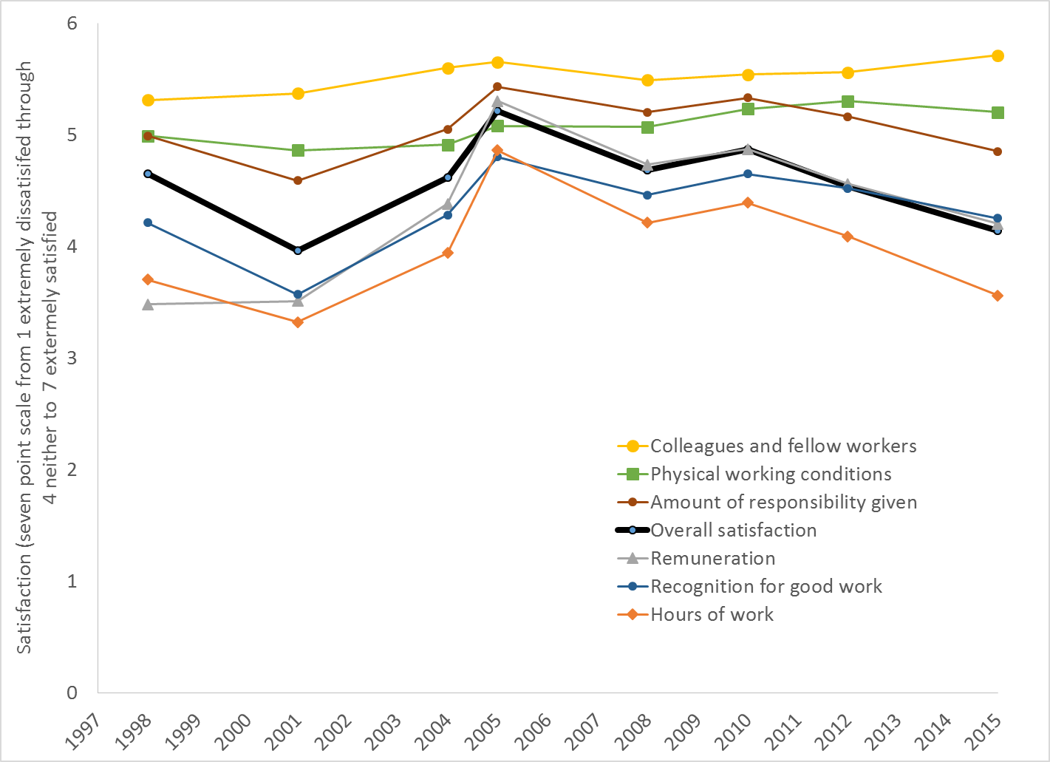
GP income and working lives (England)
GP personal income
GP satisfaction with work
http://www.sspc.ac.uk/media/media_486342_en.pdf
Data from the Eighth National GP Survey
http://research.bmh.manchester.ac.uk/healtheconomics/research/Reports/EighthNationalGPWorklifeSurveyreport/

Slide 4
What did QOF achieve?
Some improvement in quality (complicated)
Reductions in inequalities at practice level
Evidence of change in organisation of care
Nurse led chronic disease care
Specialist (fragmented) model of care
Implementation failures
Payment formula wrong (capitation not great either)
Later indicators less successful (eg depression)
Ran out of indicators that were “QOFable”

Slide 5
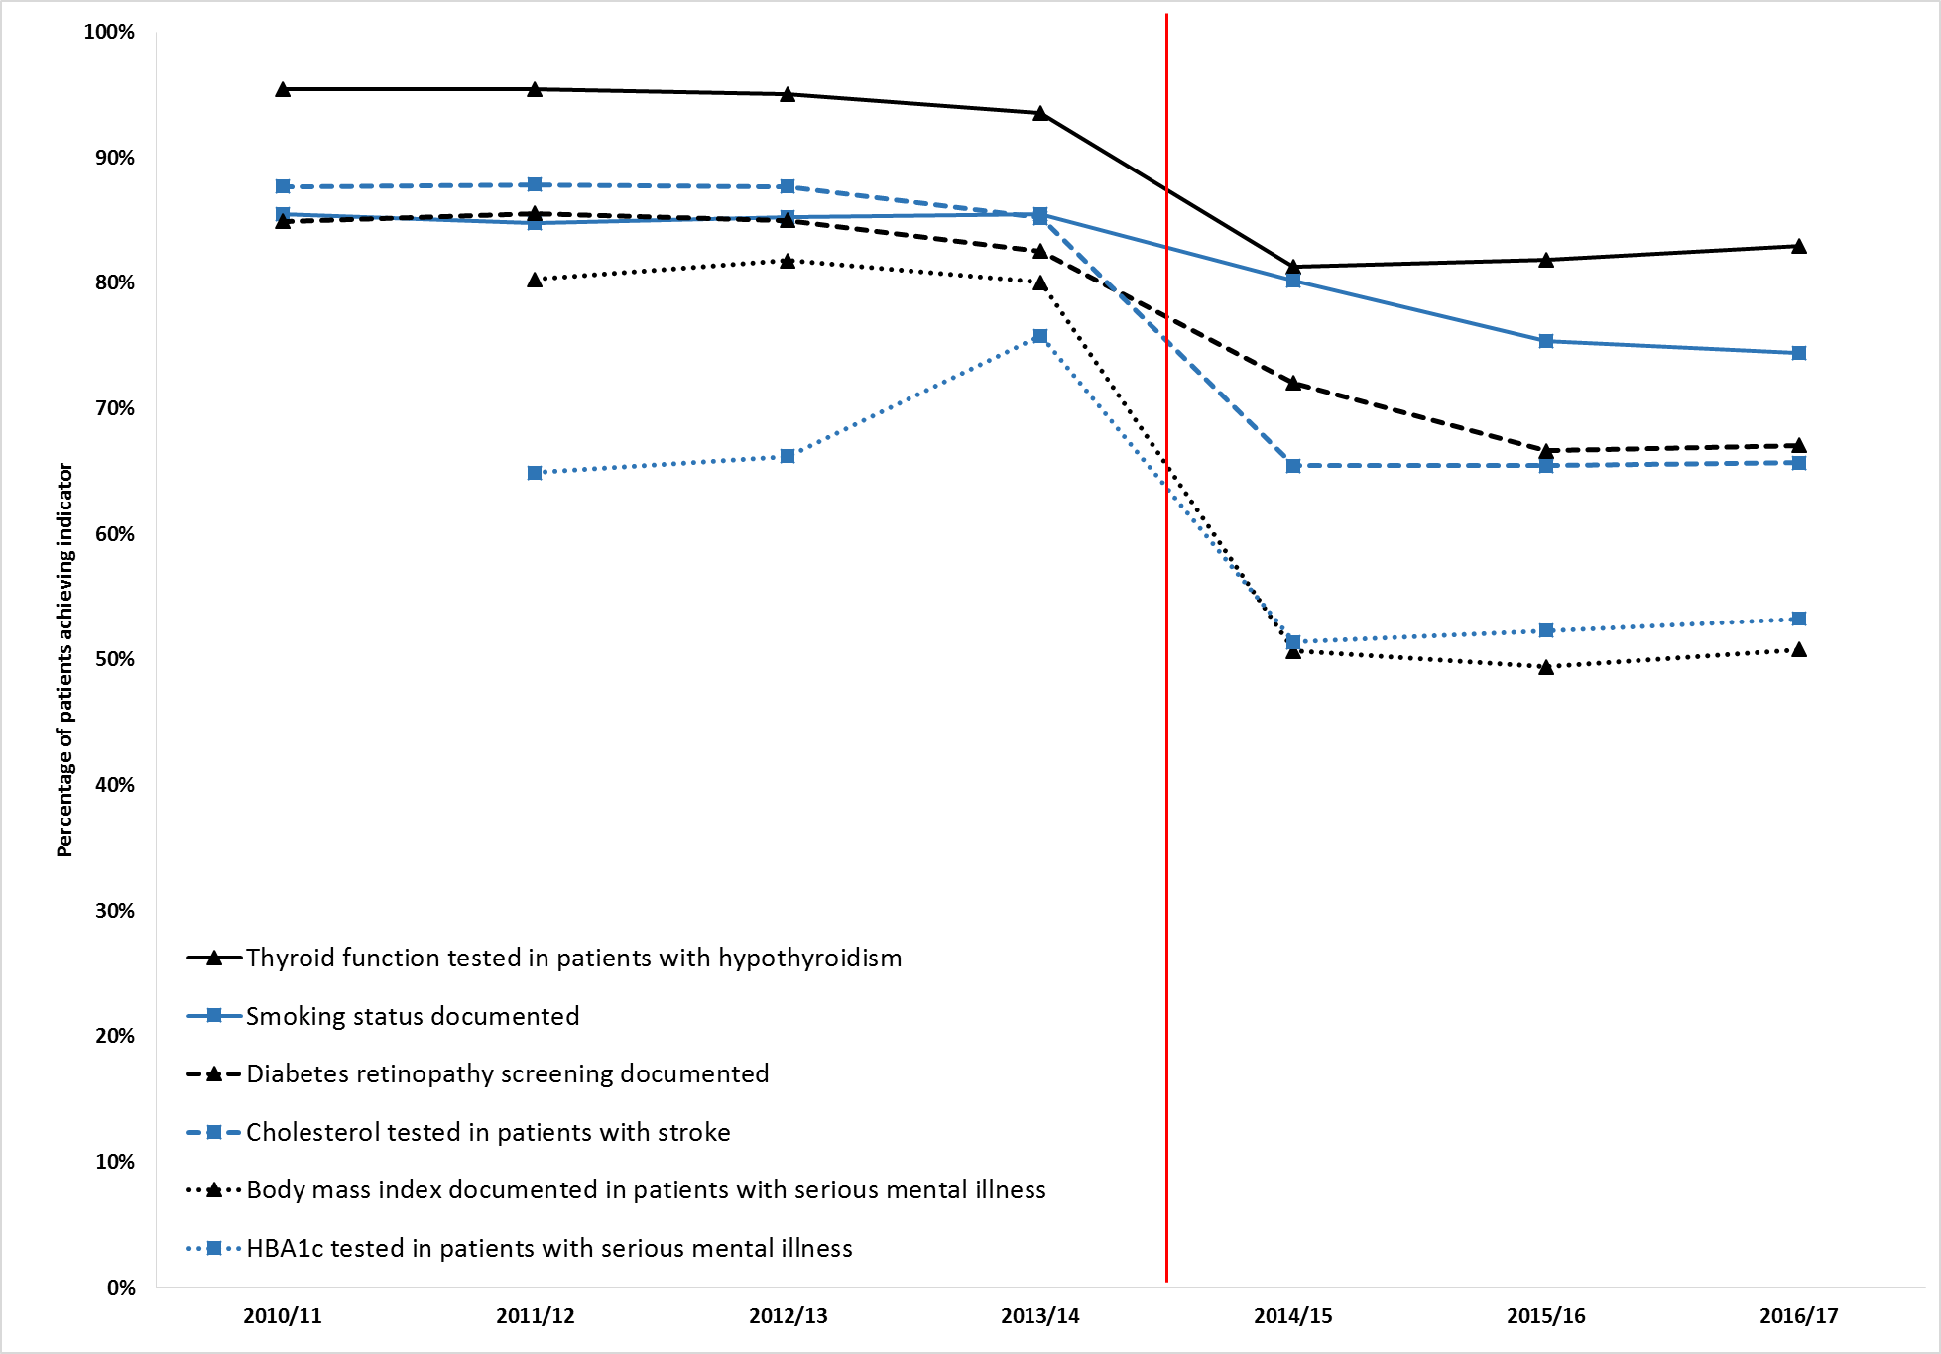
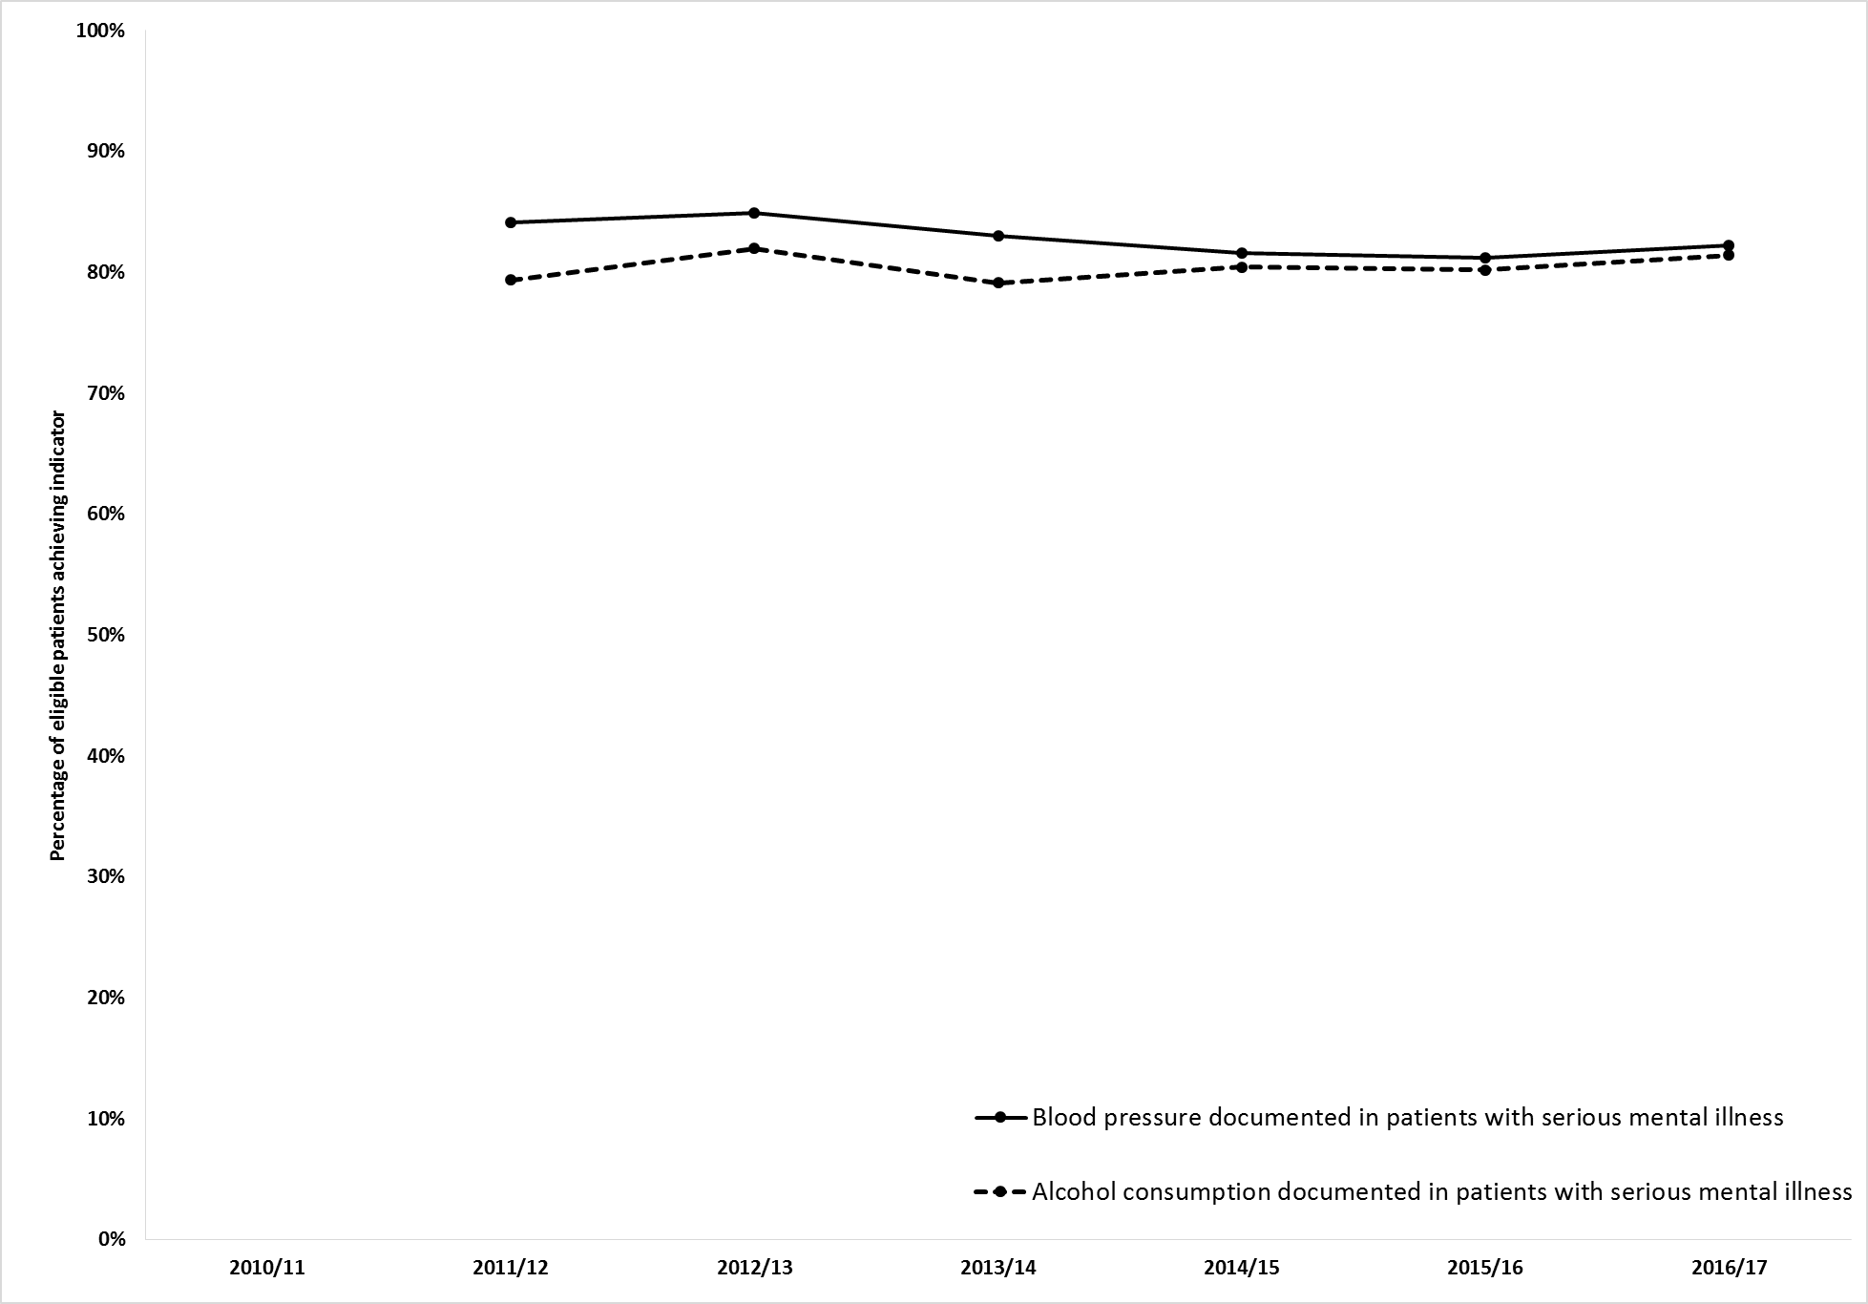
What happens when QOF stops?
Segmented regression analysis – all changes stat sig
Can’t distinguish changed documentation vs practice
Minchin M et al. New England Journal of Medicine 2018;379(10):948-57

Slide 6
What happens when QOF stops?
Segmented regression analysis – all changes stat sig
Can’t distinguish changed documentation vs practice
Minchin M et al. New England Journal of Medicine 2018;379(10):948-57

Slide 7
What happens when QOF stops?
Segmented regression analysis – all changes stat sig
Can’t distinguish changed documentation vs practice
Minchin M et al. New England Journal of Medicine 2018;379(10):948-57

Slide 8
What does it mean?
QOF didn’t always measure what mattered
Who cares about measuring cholesterol annually?
Throwing the baby out with the bathwater?
We do care about regular blood pressure measurement and control
We do care about many diabetes processes and intermediate outcomes
We do care about medication review
Payers dilemma – how do you know it’s worked?

Slide 9
Summary
P4P small effects on introduction
Initial indicators aligned with internal motivation
Some later indicators were not (and failed)
Effects appear to be lost on withdrawal
Need to examine actual treatment and care...
… but it is worrying
Embed in wider improvement programmes?
May buy engagement -> use other methods to win hearts and minds, & facilitate organisational change?
Could do with more RCTs or planned evaluation…

