Slide 1
Safe and Sustainable
General Practice
Dr Carey Lunan
GP, Craigmillar
Chair of RCGP Scotland
Carey.Lunan@rcgp.org.uk
@careylunan
Notes:
x

Slide 2
Being a GP can be a tough gig.

Slide 3
A few reasons why…
Declining WTE workforce
Increasing workload – complexity, intensity
Changing population demographic
Public expectations
…
Notes:
We have good working relationships with SGPC; meet monthly to trouble-shoot, discuss hot topics, plan collaboarive working, act as critical friends
Recognise we have different spheres of influence and expertise

Slide 4
8 Chapters:
The Role of the GP
Workload and Wellbeing
Workforce
Quality
The Interface
Health Inequalities
The patient voice
Funding

Slide 5
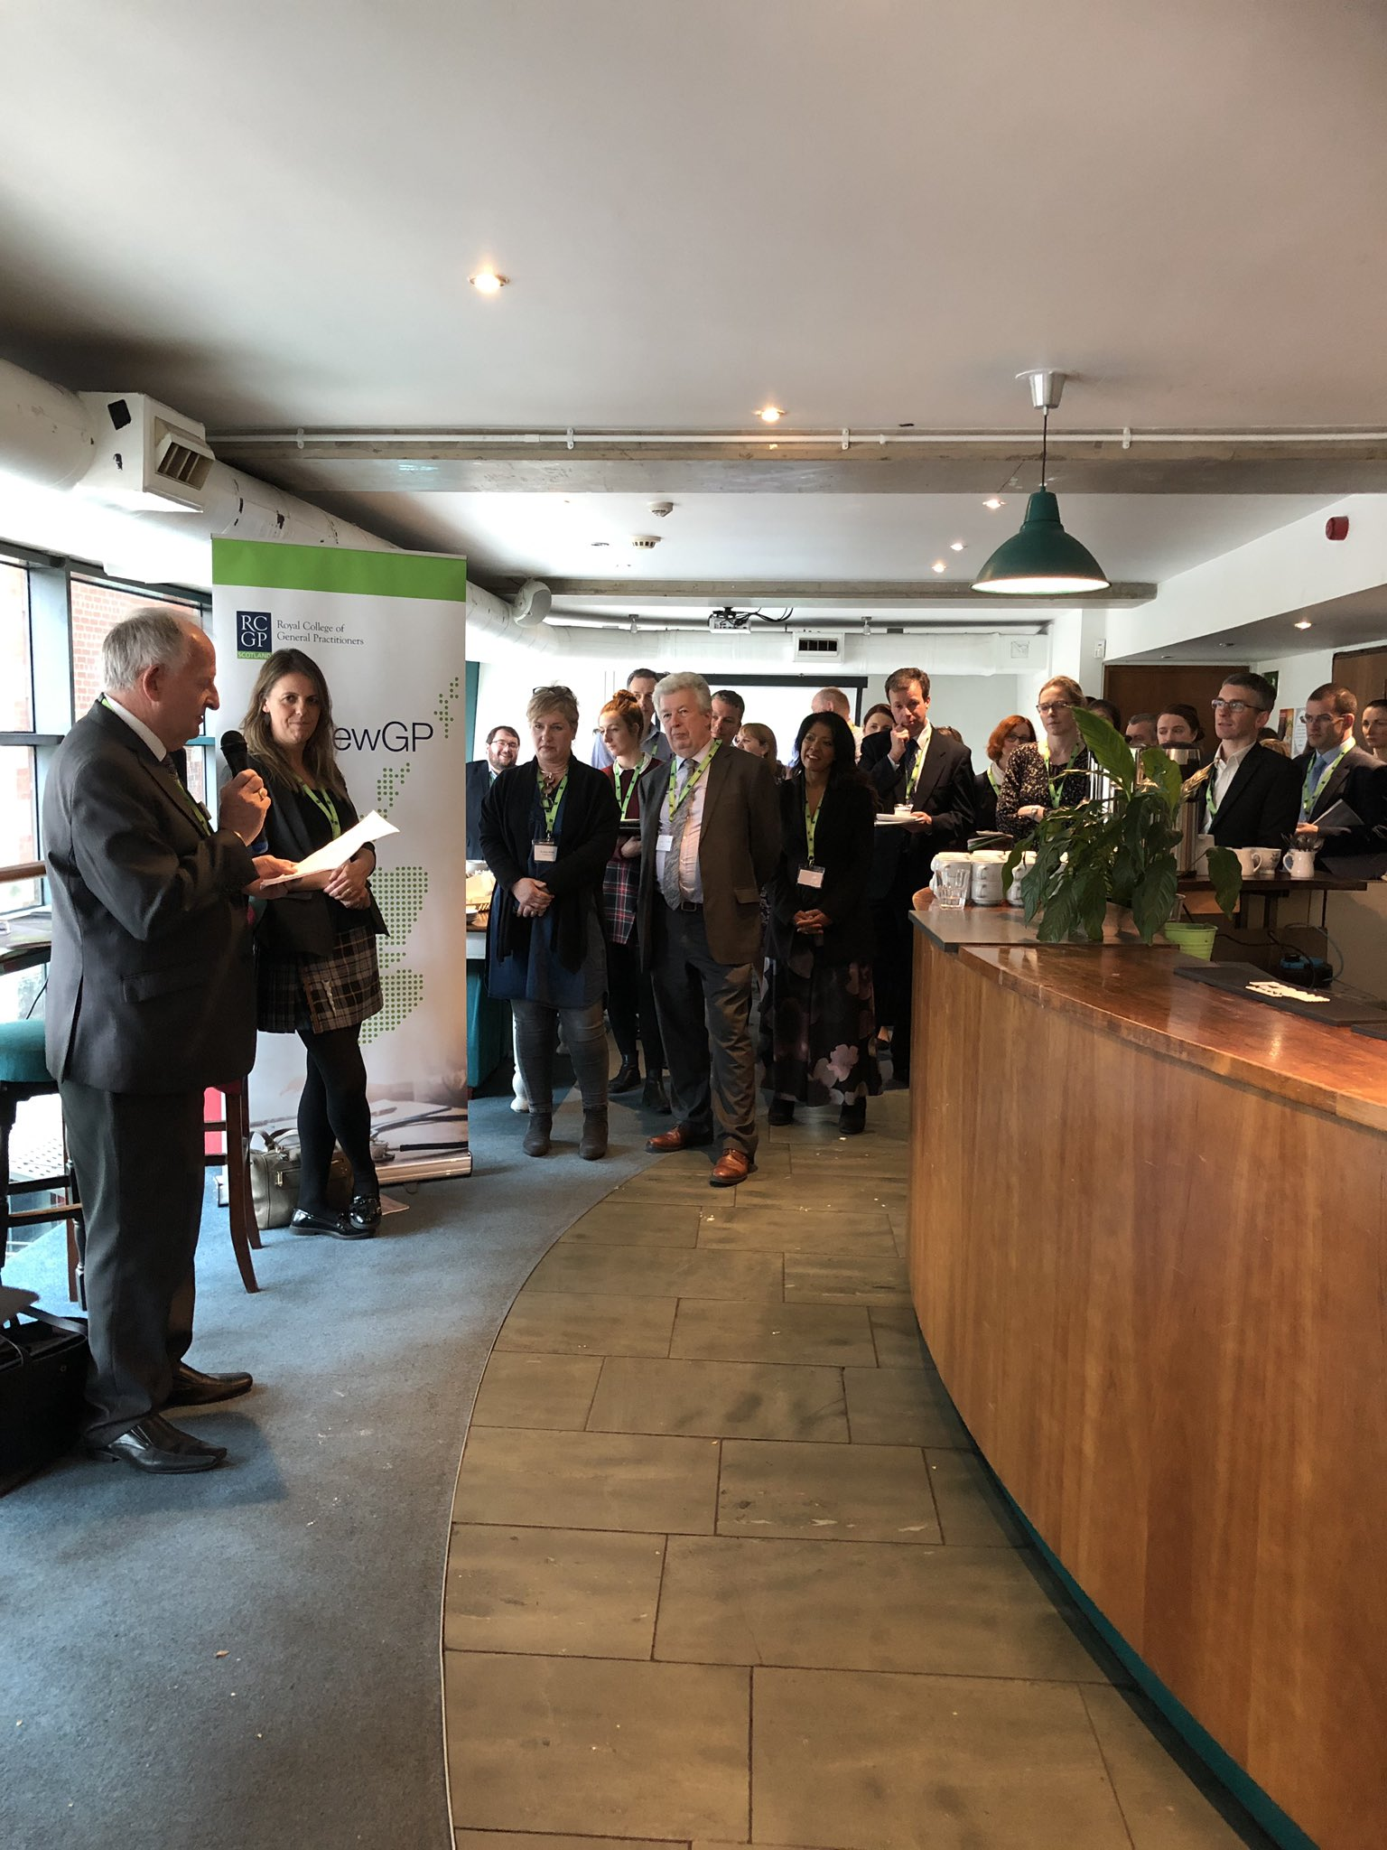
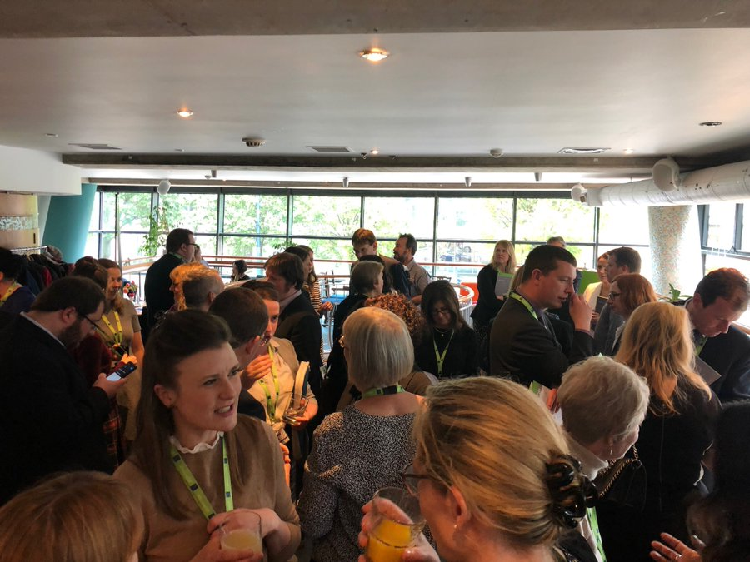
#RenewGP Campaign

Slide 8
Topics for discussion
Workforce
Wellbeing
Public engagement

Slide 9
Topics for discussion
Workforce
Wellbeing
Public engagement

Slide 10
Workforce
The GP workforce
The MDT workforce

Slide 11
Building the GP workforce
School
Medical school
GP retention
GP training
“…an additional 800 (headcount) GPs by 2027”
Scottish Government
Notes:
The concept of career flow and the importance of considering every part of this to improve workforce figures

Slide 12
Building the GP Workforce
Work with schools
#DestinationGP findings
Gillies report
Longer GP training
Retention – how and why to stay?
https://www.rcgp.org.uk/destinationgp
Notes:
extra £5m for undergraduate education in general practice.

Slide 13
MDT workforce
Challenges and opportunities
RCGP approach
Fostering a collective voice
Joint teaching events (NES)

Slide 14
Benefits of MDT working | Challenges of MDT working
Potential to reduce GP workloads | Availability of members of the MDT
Helps ensure patients are seen by right patient at the right time | Lack of time for GPs to engage in the development of teams and capacity of premises to accommodate them
Educational benefits exist from working alongside expert colleagues across professions | Lack of clarity of professional roles, responsibilities and competencies within the team
GPs have more time to care for patients with the most complex health and social care needs | Mentoring and supervision requirements for new colleagues takes time
Has potential to reduce referral rates to secondary care as more patients can be treated within primary care | A general lack of patient understanding and education over what MDT working will mean for them

Slide 15
Fostering a Collective Voice
The Primary Care Clinical Professionals Group
Notes:
Helped form the Primary Care Clinical Professionals’ Group (PCCPG) which brings together a number of professional organisations representing key professions within the MDT
Through PCCPG we have created a joint statement on the digital requirements for MDT working in Scotland as well as offering a joint definition of primary care
We were involved alongside NHS Education for Scotland (NES) to deliver joint teaching for MDTs

Slide 16
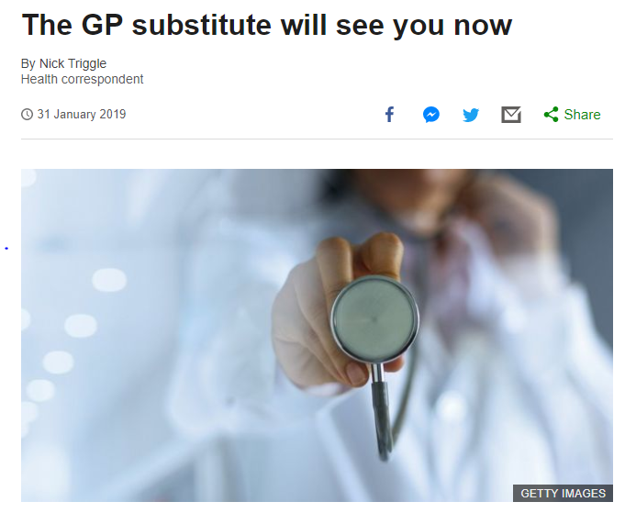
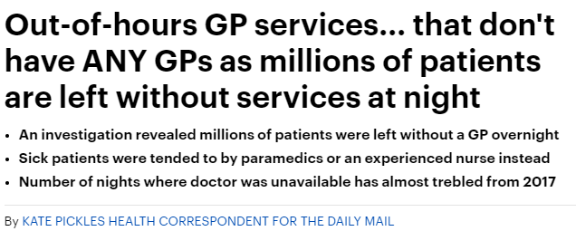
Challenging unhelpful language
Notes:
x

Slide 17
Key Asks from our Campaign
WTE workforce planning
Proactive identification struggling practices
Research into retention factors
Build the undergraduate capacity
Recognition on GMC register
Infrastructure to support MDT working
Notes:
We continue to lobby the GMC for a change in the registration status of GPs
This needs to happen asap, least of all to address the parity/status issues that we know influence career choice of medical students, how we value ourselves as a profession and how we are perceived by public and politicians

Slide 18
Topics for discussion
Workforce
Wellbeing
Public engagement

Slide 19
Wellbeing
Boiling Frogs and Burning Out
Notes:
It is estimated that around 1/3 of our consultations have a mental health component; often it feels like more! But how good are we are protecting own mental health?
This was a title from a BMJ article a few months ago – some of you may have seen it. It speaks about the gradual acclimation that we (the frogs) make to an increasingly unsafe and hot working environment (the NHS) until it has become so hot, without us noticing that we are at risk of being boiled or burned.
There have been increasing numbers of articles published in recent months on GP wellbeing. I imagine that most of us in the room experience work-related stress on a regular basis – especially as a trainer! But what can we do about it?
Analysis of research by RCGP Scotland shows that more than one in five of Scottish GPs (22%) say they are so stressed they feel they cannot cope at least once a week. In addition, the majority are concerned their stress levels may increase further over the next few years.

Slide 20
RCGP wellbeing survey 2018
Workload cited as most common factor
Workload is physical, cognitive, emotional
Feeling so overwhelmed at least once a week that cannot cope (37%)
Stress impacting on ability to make decisions (35%)
Stressed about risk and uncertainty in 10 minute appt (86%)
Significant factor in reducing hours worked
Notes:
Our wellbeing survey has provided a more robust evidence base for what was more anecdotal before
It mirrors the results from other surveys of GP wellbeing; specifically the BMA and the SSPC

Slide 21
“an anxious, fatigued, beyond capacity workforce is far less able to manage risk, tolerate uncertainty and choose the less well trodden paths of care”.
Notes:
We have used these results to inform chapter 2 of our major campaign on behalf of the profession in Scotland, launched in June 2019
Available online – could share a copy for the group

Slide 22
Key asks from our campaign:
Longer consultation times
Change in appraisal focus
Improving the 1-2 interface
Support for Clusters
Formalise support structures for doctors
National Conversation about NHS use
Notes:
This chapter detailed our programme of work and ambitions....talk around each briefly in terms of what we are doing

Slide 23
Change in appraisal focus
Proposed joint vision statement (draft):
“Our organisations collectively support a shift in the focus and culture of the appraisal process to one that prioritises the wellbeing of our workforce. We support a reduction in unnecessary paperwork prior to appraisal, and a quality conversation within appraisal that specifically focuses on wellbeing and safe working environments, whilst also recognising the requirement for appraisal to maintain public confidence that their doctors are maintaining their professional competencies.”
Notes:
A key theme identified in the analysis of this survey was the negative experience of many GPs of the existing appraisal process. Although it is recognised that not all GPs experience appraisal as negative, for a significant percentage of respondents it was viewed as a burdensome and “tick-box” process, with a significant amount of personal time spent on the preparatory paperwork. There was also evidence that the anxiety created by appraisal and revalidation was a significant factor contributing to some GPs leaving the profession earlier than planned. Anecdotal evidence from discussion with hospital doctors would suggest that these findings may be replicated if the survey were carried out with other medical specialities.

Slide 24
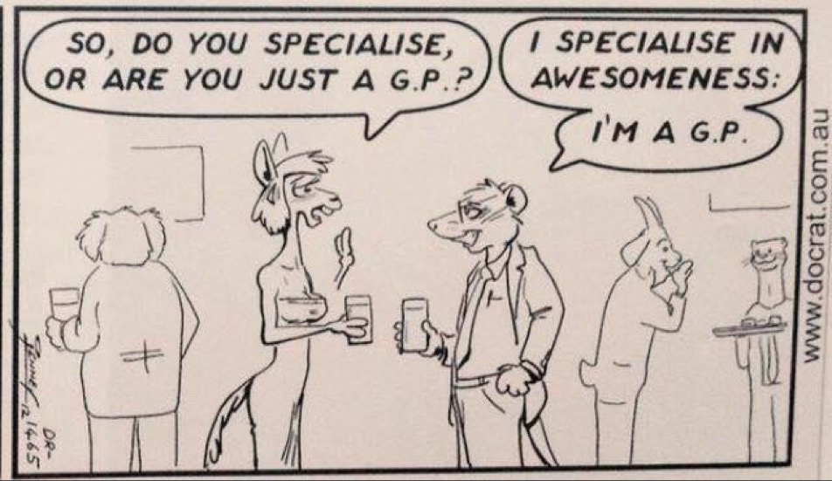
Improving the 1-2 care interface
#DestinationGP
Interface Groups project
Cross-College group
Interface workshops
Work shadowing
(SOAR template https://bit.ly/2EGpWJj )

Slide 25
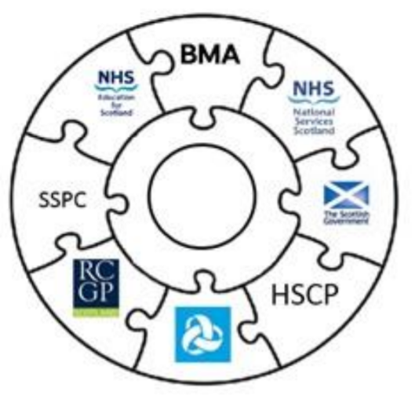
Support for Clusters
New joint national guidance
Ongoing quality assurance work
Notes:
sets out recommended minimum expectations for Clusters and the wider system support required to enable and develop the Cluster role and function.

Slide 26
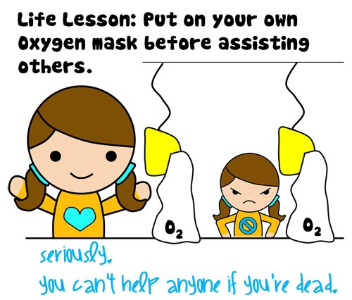
Formalise supports for GPs
Scottish Practitioner Health Programme
SGPC – LMC conference November 2019
GMC/NES Wellbeing AG – work stream
Support of CMO, Cab Sec

Slide 27
Topics for discussion
Workforce
Wellbeing
Public engagement

Slide 28
A National Conversation

Slide 29
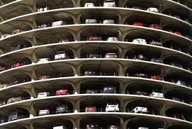

Slide 30
Question 1:
How do we, as a society, have a meaningful national conversation around future sustainable use of the NHS, seventy years after its inception, in the face of rising public expectation and demand?
Notes:
In my mind there are two strategic “layers” to this, separate but related. First and foremost is around how we, as a society, have a meaningful national conversation around future sustainable use of the NHS, seventy years after its inception, in the face of rising public expectation and demand. The second more specific issue for GPs at the current time is how we engage and educate the public about the new models of primary care under the new GP contract in Scotland which involves delegating, as appropriate, clinical work to other members of the wider multi-disciplinary team, with receptionists playing an active role in non-clinical triage and “signposting” at the point of contact with the practice.

Slide 31
Or put another way…
Is this what
the NHS is for?

Slide 32
Question 2:
How do we engage and educate the public about the new models of primary care under the new GP contract in Scotland?
Notes:
The second more specific issue for GPs at the current time is how we engage and educate the public about the new models of primary care under the new GP contract in Scotland which involves delegating, as appropriate, clinical work to other members of the wider multi-disciplinary team, with receptionists playing an active role in non-clinical triage and “signposting” at the point of contact with the practice.

Slide 33
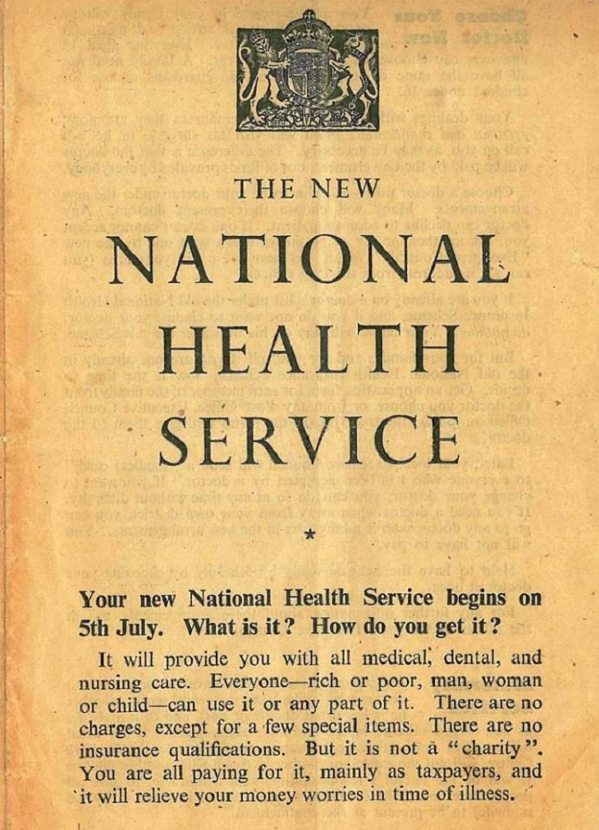
“special premises known as Health Centres may be opened in your district. Doctors may be accommodated there instead of their own surgeries, but you will still have “your own doctor” to give you personal and confidential treatment. He will come to your home as necessary. At the Health Centre he will be able to use equipment provided from public funds…”
Notes:
Since the establishment of the NHS in 1948, what it means to be a GP has changed, almost beyond recognition. With advancing medical technologies, new medicines, new medical knowledge and improvements in public health, life expectancy continues to rise. Many conditions that would previously have meant a terminal diagnosis or a hospital admission are now managed entirely in the community setting. The role of the GP has adapted enormously to meet these challenges. But there are also many fundamental aspects of what it means to be a GP that have not changed – yet.

Slide 34
RCGP Tracking survey 2018
How often do you spend time in a consultation explaining new models of care to patients?
How often do you experience patients feeling distressed, angry, or confused about new models of care?
Notes:
At the level of primary care, there has been much anecdotal evidence from GPs that many patients are struggling to accept and navigate the new systems, and that this is putting additional strain on practices. This narrative has been reinforced in the results of the latest RCGP tracking survey, which polls all its members on current issues affecting the profession. Two questions were included for Scottish GPs to gauge how patients were responding to these changes, with the majority of respondents stating that both significant levels of clinical time were being spent educating patients, and that significant numbers of patients were expressing distress, anger or confusion at being asked for additional information by reception colleagues when contacting the practice. This has provided a useful evidence base for the need for any local education to be supplemented and supported by a national education campaign. We intend to suggest the development of a “toolkit” for practices to help educate their patients about these change (slides for waiting rooms screens, messages on phone systems, wording on website, information leaflets etc) and enlist the support of the Board-level patient engagement champions to reinforce the messaging. Training for receptionists (increasingly now taking on the role of care coordinators) remains variable across the country and there is the potential to use existing training resources (eg NHS24, Scottish Primary Care Collaborative) to improve this and support practices, many of whom are trying to deliver this training in-house.

Slide 35
RCGP engagement
Scottish Academy
Primary Care Professionals
BMA
Director General NHS Scotland
CMO
Cabinet Secretary for Health and Sport
Patient Groups

Slide 36
Letter to JF
Notes:
In November, RCGP wrote to Cabinet Secretary Jeane Freeman about this issue (letter attached). Co-signatories on the letter included the Chair of the Scottish General Practitioner Committee of the BMA, the Chair of the RCGP Scotland Patient Participation Group “P3” and Chair of the Royal College of Nursing, on behalf of the wider Primary Care Clinical Professionals Group. We explicitly wished to offer our support to work jointly with Scottish Government to develop public messaging. The following week, at the Scottish Local Medical Committee (BMA) annual conference, the Cabinet Secretary announced her intention for Scottish Government to provide national leadership on this and work in partnership with healthcare professionals on a public engagement exercise.

Slide 37
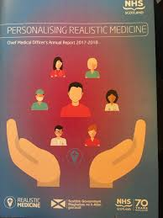
Personalising Realistic Medicine
“The value of engaging our citizens is increasingly recognised. For example, following the introduction of the new GP contract in Scotland, the Scottish Government have begun to collaborate with stakeholders, including the Royal College of General Practitioners (Scotland) and the British Medical Association, to lead a national conversation to increase the public’s understanding of the new models of primary care”

Slide 38
Practices can’t do it alone…

Slide 39
Levels of engagement
Practices
Health Boards
National

Slide 40
The Leith Agency

Slide 41
Thank you.

